Slide 1
CHAPTER
17 Capital and Time

Slide 2
Capital and the Rate of Return
The capital stock of an economy
  The sum total of machines, buildings, and other reproducible resources in existence at a point in time
  Represent some part of the economy’s past output that was set aside for future production

Slide 3
17.1 Two Views of Capital Accumulation
Consumption
Consumption
x
y
c₀
c₀
s
s
t₁
t₂
t₃
Time
t₁
t₂
t₃
Time
(a) One-period return
(b) Perpetual return
In (a), society withdraws some current consumption (s) to gorge itself (with x extra consumption) in the next period. The one-period rate of return would be measured by x/s - 1. The society in (b) takes a more long-term view and uses s to increase its consumption perpetually by y. The perpetual rate of return would be given by y/s.

Slide 4
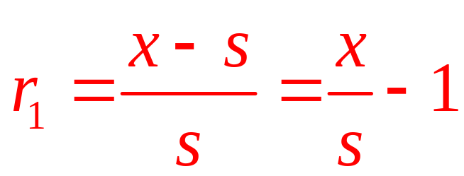
Rate of Return
Single period rate of return (r₁)
  On an investment
  Is the extra consumption provided in period 2 as a fraction of the consumption forgone in period 1

Slide 5
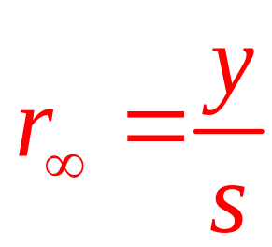
Rate of Return
Perpetual rate of return (r∞)
  Is the permanent increment to future consumption expressed as a fraction of the initial consumption foregone

Slide 6
Rate of Return
Rate of return to capital accumulation
  Something between these two extremes
  A measure of the terms at which consumption today may be turned into consumption tomorrow

Slide 7
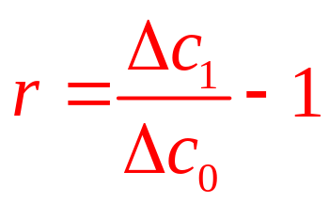
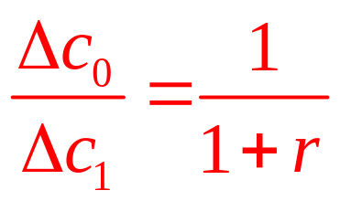
Rate of Return and Price of Future Goods
Assume that there are only two periods
  The rate of return between these two periods (r) is defined to be
  Rewriting, we get

Slide 8
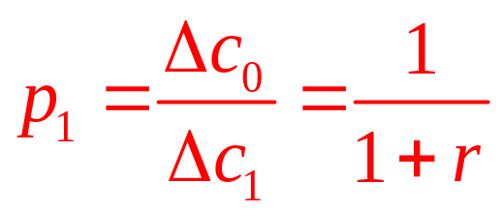
Rate of Return and Price of Future Goods
Relative price of future goods (p₁)
  Is the quantity of present goods that must be foregone to increase future consumption by one unit

Slide 9
Demand for Future Goods
An individual’s utility
  Depends on present and future consumption, U = u(c₀,c₁)
  And the individual must decide how much current wealth (W) to devote to these two goods
The budget constraint: W = c₀ + p₁c₁

Slide 10
17.2 Individual’s Intertemporal Utility
Maximization
Future Consumption (c₁)
W = c₀ + p₁c₁
When faced with the intertemporal budget constraint W = c₀ + p₁c₁, the individual will maximize utility by choosing to consume c₀* currently and c₁* in the next period. A decrease in p₁ (an increase in the rate of return, r) will cause c₁ to increase, but the effect on c₀ is indeterminate because substitution and income effects operate in opposite directions (assuming that both c₀ and c₁ are normal goods).
W/p₁
c₁*
•
U₂
U₁
U₀
c₀*
W
Current consumption (c₀)

Slide 11
Utility Maximization
The individual
  Consumes c₀* in the present period
  Chooses to save W - c₀* to consume next period
This future consumption
  Can be found from the budget constraint
p₁c₁* = W - c₀*
c₁* = (W - c₀*)/p₁
c₁* = (W - c₀*)(1 + r)

Slide 12
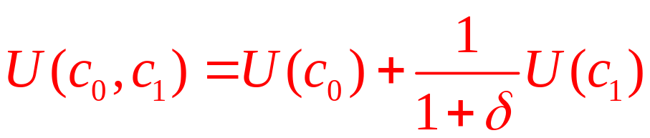
17.1 Intertemporal Impatience
Individuals’ utility-maximizing choices over time
  Depend on how they feel about waiting for future consumption
Assume
  An individual’s utility function for consumption [U(c)] is the same for both periods
  But period 1’s utility is discounted by a “rate of time preference” of 1/(1+δ) (where δ>0)

Slide 13
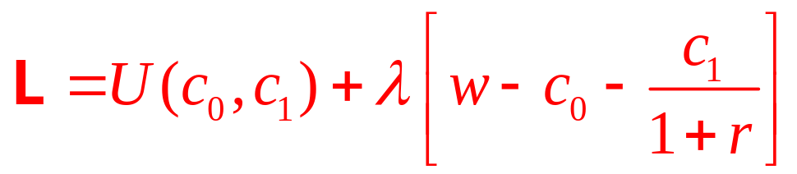
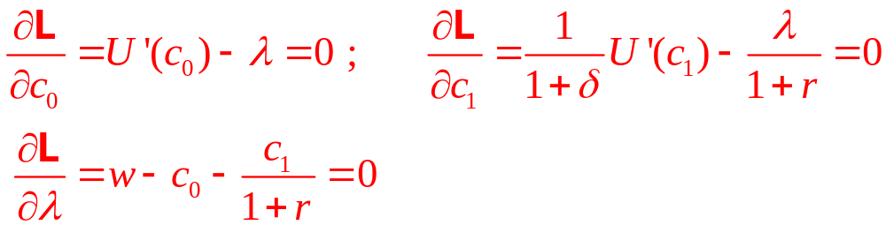
17.1 Intertemporal Impatience
Maximization of this function
  Subject to the intertemporal budget constraint
  Yields the Lagrangian expression:
  The first-order conditions:

Slide 14
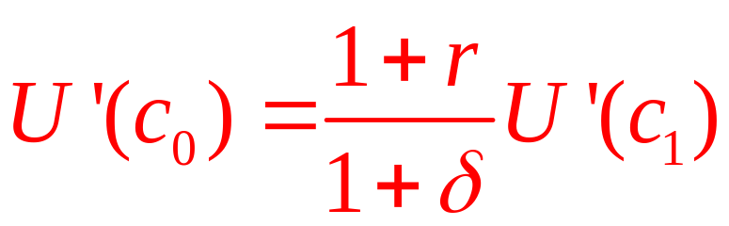
17.1 Intertemporal Impatience
Dividing the first and second conditions and rearranging, we find:
Therefore,
  If r = δ, c₀ = c₁
  If r < δ, c₀ > c₁
  If r > δ, c₀ < c₁

Slide 15
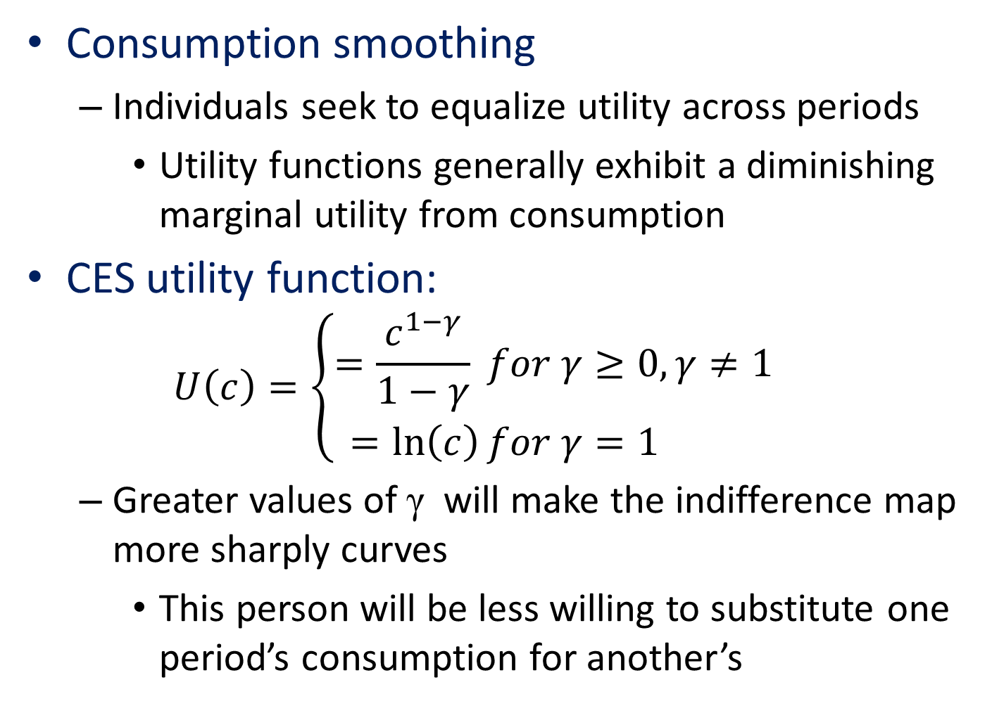
17.1 Intertemporal Impatience
Consumption smoothing
  Individuals seek to equalize utility across periods
    Utility functions generally exhibit a diminishing marginal utility from consumption
CES utility function:
  $$U\left(c\right)=\left\{\begin{aligned}=\frac{c^{1−γ}}{1−γ} for γ≥0, γ≠1 \\ =\ln\left(c\right)for γ=1 \end{aligned}\right.$$
  Greater values of γ will make the indifference map more sharply curves
    This person will be less willing to substitute one period’s consumption for another’s

Slide 16
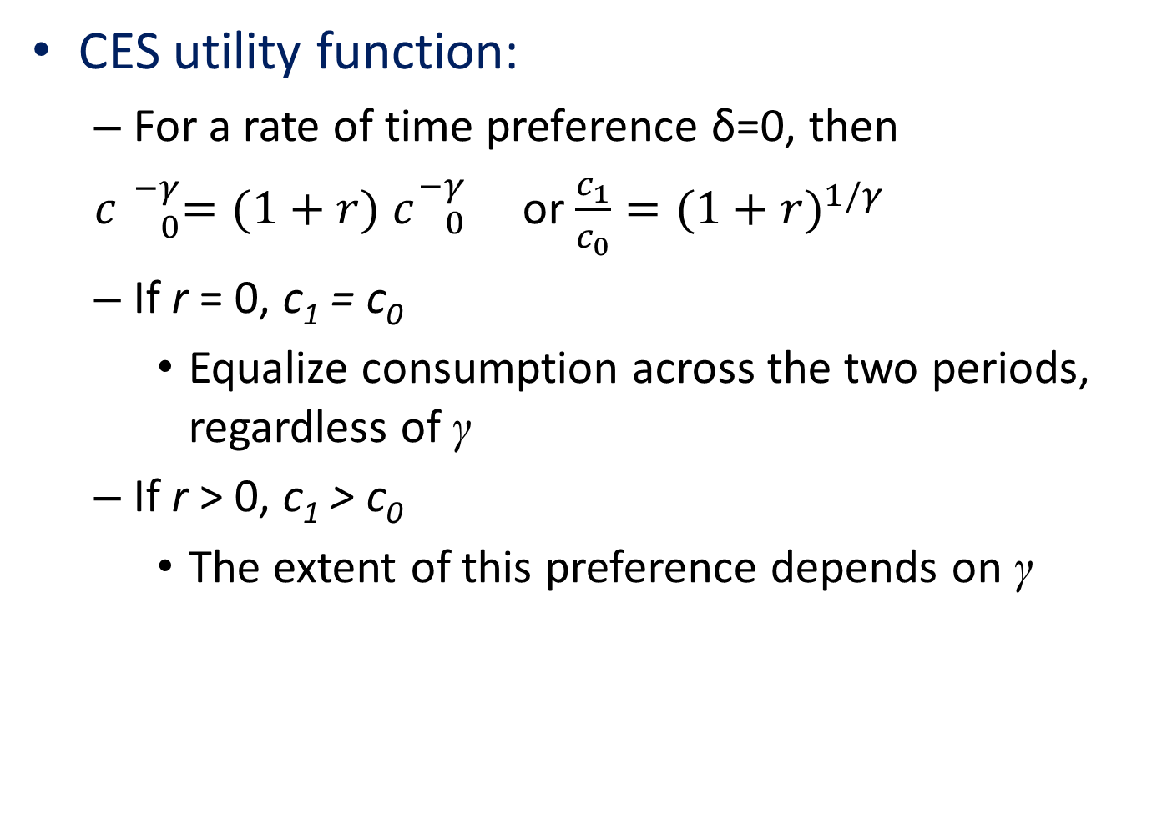
17.1 Intertemporal Impatience
CES utility function:
  For a rate of time preference δ=0, then
  $c{}_{0}^{−γ}{=(1+r)}$ $c{}_{0}^{−γ}{}$ or $\frac{c_{1}}{c_{0}}={(1+r)}^{1/γ}$
  If r = 0, c₁ = c₀
    Equalize consumption across the two periods, regardless of γ
  If r > 0, c₁ > c₀
    The extent of this preference depends on γ

Slide 17
Effects of Changes in r
If r rises (and p₁ falls)
  Both income and substitution effects will cause more c₁ to be demanded
  Unless c₁ is inferior (unlikely)
  This implies that the demand curve for c₁ will be downward sloping

Slide 18
Effects of Changes in r
The sign of ∂c₀/∂p₁ is ambiguous
  The substitution and income effects work in opposite directions
  We cannot make an accurate prediction about how a change in the rate of return affects current consumption

Slide 19
17.3 Determination of the Equilibrium Price of
Future Goods
Price (p₁)
S
The point p₁*,c₁* represents an equilibrium in the market for future goods. The equilibrium price of future goods determines the rate of return.
p₁*
•
D
c₁*
Future consumption (c₁)

Slide 20
Supply of Future Goods
An increase in the relative price of future goods (p₁)
  Will likely induce firms to produce more of them because the yield from doing so is now greater
  The supply curve will be upward sloping

Slide 21
Equilibrium Price of Future Goods
We expect that p₁ < 1
  Individuals require some reward for waiting
  Capital accumulation is “productive”
    Sacrificing one good today will yield more than one good in the future

Slide 22
The Equilibrium Rate of Return
The price of future goods: p₁* = 1/(1+r*)
  Determined in the market for those goods
  Because p₁* is assumed to be < 1
    The rate of return, r*= (1- p₁*)/ p₁*, will be positive
p₁* and r*
  Are equivalent ways of measuring the terms on which present goods can be turned into future goods

Slide 23
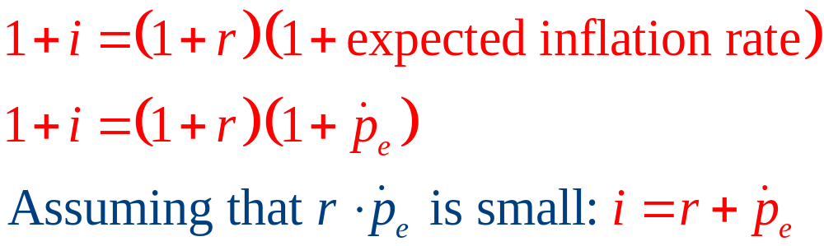
Rate of return, real interest rates, and nominal interest rates
Rate of return and the real interest rate
  Refer to the real return that is available from capital accumulation
Nominal interest rate (i) is given by

Slide 24
17.2 Determination of the Real Interest Rate
Simple model of real interest rate determination
  Can be developed by assuming that consumption grows at some exogenous rate, g
  The real interest rate must adjust so that consumers are willing to accept this rate of growth in consumption

Slide 25
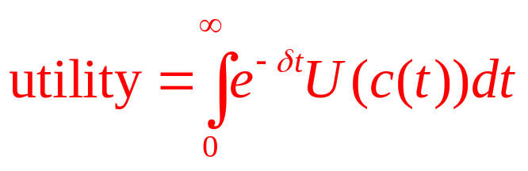
17.2 Determination of the Real Interest Rate
Optimal consumption
  Maximize the utility received from this consumption over time
    Where δ is the rate of pure time preference
At each instant of time, this person
  Earns a wage w
  Earns interest r on his or her capital stock k
Capital: dk/dt = w + rk – c
  And is bound by the endpoint constraints:
  k(0) = 0 and k(∞) = 0

Slide 26
17.2 Determination of the Real Interest Rate
  Setting up the augmented Hamiltonian for this dynamic optimization problem yields:
H = e^{-δt}U(c) + λ(w + rk –c) + k dλ/dt
  The “maximum principle” requires:
H_{c} = e^{-δt}U’(c) – λ = 0
H_{k} = rλ + dλ/dt = 0 or rλ = - dλ/dt
  Solving, we get: λ = e^{–rt} ; so: U’(c) = e^{(δ-r)t}
    Marginal utility should increase or decrease over time
    Depending on the relationship between the rate of time preference and the real rate of interest

Slide 27
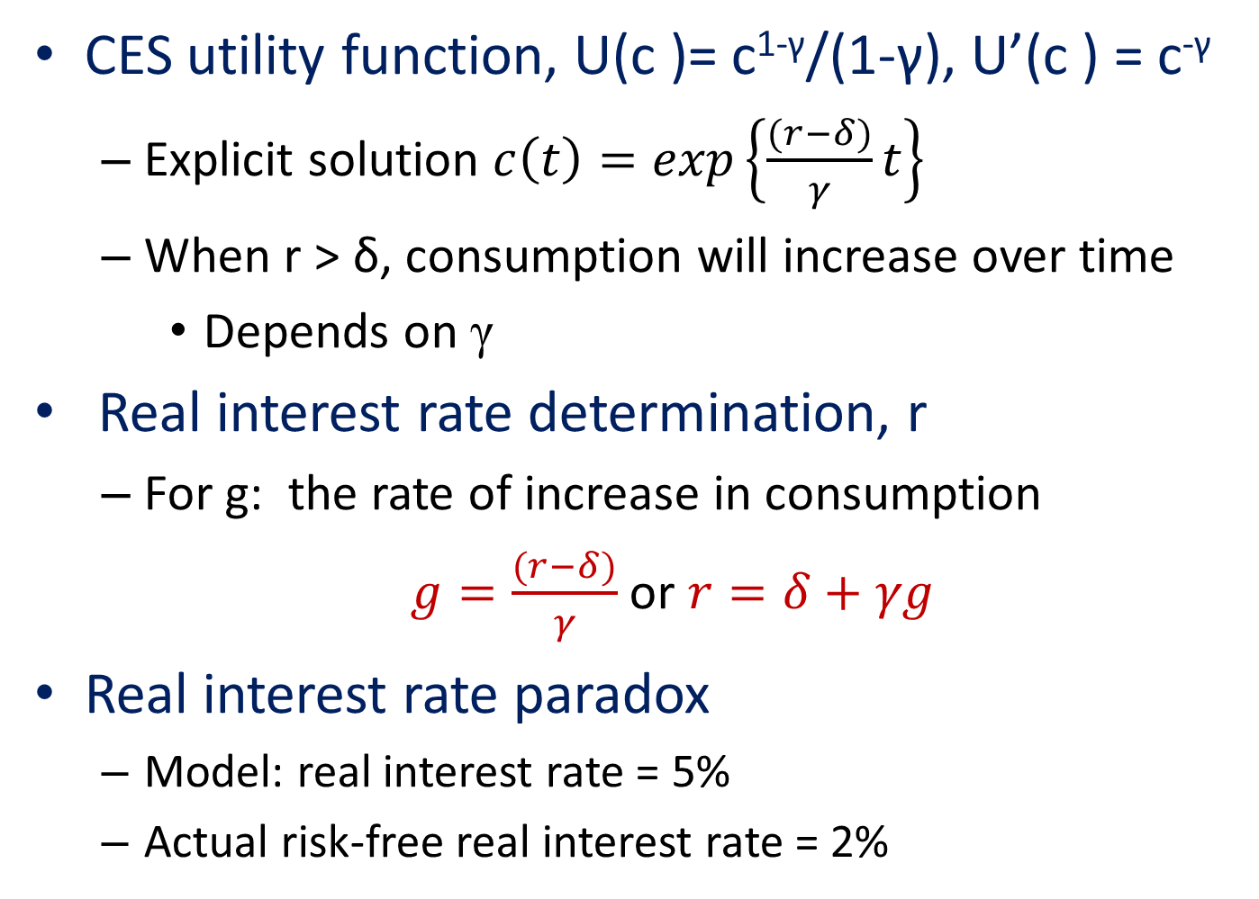
17.2 Determination of the Real Interest Rate
CES utility function, U(c )= c^{1-γ}/(1-γ), U’(c ) = c^{-γ}
  Explicit solution $c\left(t\right)=exp\left\{\frac{(r−δ)}{γ}t\right\}$
  When r > δ, consumption will increase over time
    Depends on γ
Real interest rate determination, r
  For g: the rate of increase in consumption
  $g=\frac{(r−δ)}{γ}$ or $r=δ+γg$
Real interest rate paradox
  Model: real interest rate = 5%
  Actual risk-free real interest rate = 2%

Slide 28
Pricing of Risky Assets
Risky asset
  A one period investment made at period 0
  That will yield an uncertain return of x_{i} in period 1
  Price in period 0: p_{i}
  We wish to discover the determinants of this price
  Gross rate of return: R_{i} =x_{i} /p_{i}, also uncertain

Slide 29
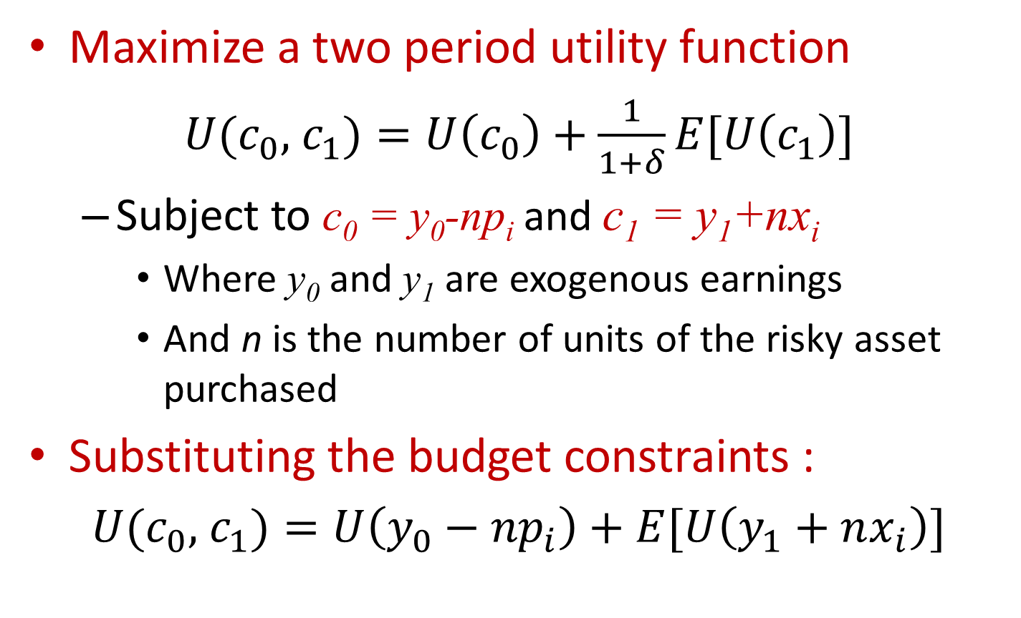
Pricing of Risky Assets
Maximize a two period utility function
$U(c_{0},$ $c_{1})=U\left(c_{0}\right)+\frac{1}{1+δ}E[U\left(c_{1}\right)]$
  Subject to c₀ = y₀-np_{i} and c₁ = y₁+nx_{i}
    Where y₀ and y₁ are exogenous earnings
    And n is the number of units of the risky asset purchased
Substituting the budget constraints :
$U(c_{0},$ $c_{1})=U\left({y_{0}−np}_{i}\right)+E[U\left(y_{1}+nx_{i}\right)]$

Slide 30
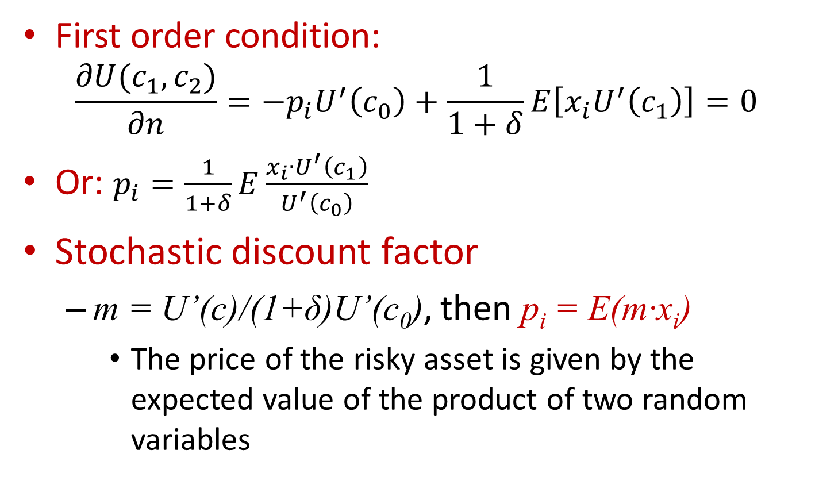
Pricing of Risky Assets
First order condition:
$$\frac{∂U(c_{1},c_{2})}{∂n}=−p_{i}U^{′}\left(c_{0}\right)+\frac{1}{1+δ}E\left[x_{i}U^{′}\left(c_{1}\right)\right]=0$$
Or: $p_{i}=\frac{1}{1+δ}E\frac{x_{i}{∙U}^{′}\left(c_{1}\right)}{U^{′}\left(c_{0}\right)}$
Stochastic discount factor
  m = U’(c)/(1+δ)U’(c₀), then p_{i} = E(m·x_{i})
    The price of the risky asset is given by the expected value of the product of two random variables

Slide 31
Pricing of Risky Assets
Risk-free rate of return
  The return on an asset is certain
  Denote the period 1 value of this risk free asset as x_{f}
  Then p_{f} = E(m)x_{f}
  Or R_{f} = x_{f} /p_{f} = 1/E(m) the gross return on the risk-free asset

Slide 32
Pricing of Risky Assets
Systematic and idiosyncratic risk
  Because E(x·y) = E(x)·E(y) + Cov(x,y)
  Then p_{i} = E(m·x_{i}) = E(m)·E(x_{i}) + Cov(m,x_{i})
  p_{i} = E(x_{i})/R_{f} + Cov(m,x_{i})
If Cov(m,x_{i}) = 0: idiosyncratic risk does not affect the pricing of risky assets
    The period 0 price of the risky asset = the expected value of the period 1 uncertain return discounted (using the risk-free rate) to period 0

Slide 33
Pricing of Risky Assets
Systematic risk
  Possible correlations between m and x_{i}
For a risky asset whose payoff is positively correlated with “good times”
  When good times occur
    The asset will have a favorable payoff and consumption will also be high
    m and x_{i} will be negatively correlated
    Low asset price

Slide 34
Pricing of Risky Assets
For a risky asset whose payoff is positively correlated with “bad times”
  When bad times occur
    m and x_{i} will be positively correlated
    High asset price
Pricing of risky assets
  Reflect individuals’ desire to mitigate fluctuations in consumption

Slide 35
Determinants of Market Rental Rates
Perfectly competitive market
  A firm will choose to hire that number of machines: MRP = market rental rate
A firm that rents machines to other firms
  Two types of costs:
    Depreciation on the machine
      Assumed to be a constant % (d) of the machine’s market price (p)
    Opportunity cost of the funds tied up in the machine - assumed to be real interest rate (r)

Slide 36
Determinants of Market Rental Rates
The total costs to the machine owner
  For one period: pd + pr = p(r + d)
Assume
  The machine rental market is perfectly competitive
    No long-run profits can be earned renting machines
    The rental rate per period (v) will be equal to the costs: v = p(r + d)

Slide 37
Nondepreciating Machines
If a machine does not depreciate
  d = 0 and v/p = r
An infinitely long-lived machine
  Is equivalent to a perpetual bond
  And must yield the market rate of return

Slide 38
Ownership of Machines
Firms
  Commonly own the machines they use
A firm
  Uses capital services to produce output
    These services are a flow magnitude
Assumed
  The flow of capital services is proportional to the stock of machines

Slide 39
Demand for Capital
A profit-maximizing firm
  In perfect competition
  Will hire additional capital up to the point at which the MRP_{k} = v
    v - reflects both depreciation costs and the opportunity costs of alternative investments
MRP_{k} = v = p(r+d)

Slide 40
Theory of Investment
If a firm decides it needs more capital services that it currently has
  Has two options:
    Hire more machines in the rental market
    Purchase new machinery (investment)

Slide 41
Present Discounted Value Criterion
When a firm buys a machine
  It is saving a stream of net rentals that last as long as the machine is being used
  It must compute the present discounted value (PDV) of this stream AND compare with the price of the machine

Slide 42
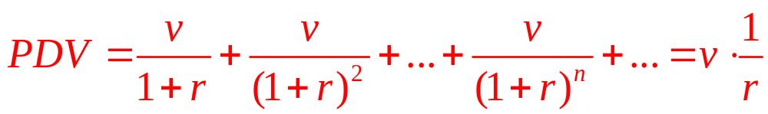
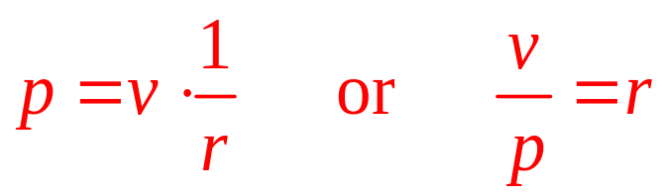
A Simple Case
Assume
  A machine’s rental rate is a constant (v) in every period
  The machine will last “forever”
The PDV from machine ownership:
In equilibrium:

Slide 43
General Case
Assume
  The rental rate for a new machine at any time s is given by v(s)
  The machine depreciates at a rate of d
    The net rental rate of the machine will decline over time
In year s
  The net rental rate of an old machine bought in a previous year (t): v(s)e ^{-d(s-t)}

Slide 44
General Case
Firm
  Considering the purchase of the machine when it is new in year t
  It should discount all of these net rental amounts back to that date
  The present value of the net rental in year s discounted back to year t is
e ^{-r(s-t)}v(s)e ^{-d(s-t)} = e^{(r+d)t}v(s)e ^{-(r+d)s}

Slide 45
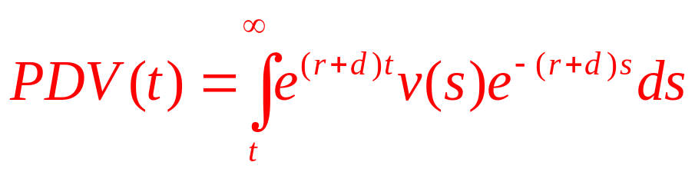
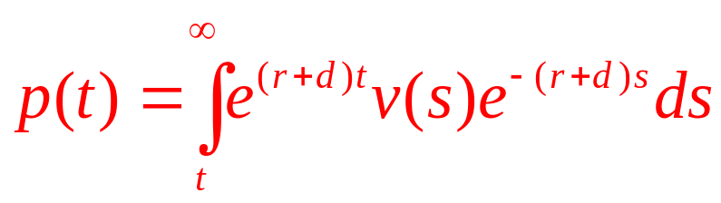
General Case
The present discounted value
  Of a machine bought in year t
  Is the sum (integral) of these present values
In equilibrium
  The price of the machine at time t [p(t)] will be equal to this present value

Slide 46
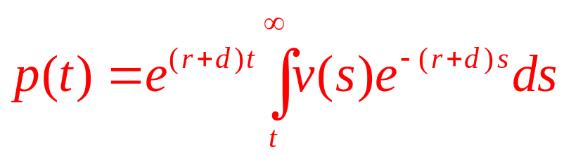
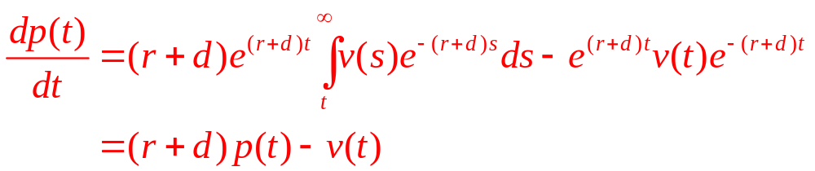
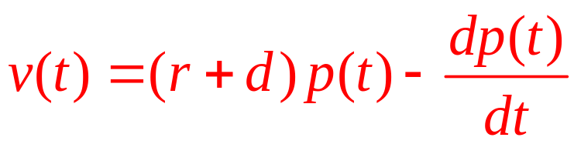
General Case
Rewriting:
Differentiating with respect to t yields:
This means:
  dp(t)/dt represents the capital gains that accrue to the owner of the machine

Slide 47
17.3 Cutting Down a Tree
A forester
  Must decide when to cut down a tree
The value of the tree at any time t
  Given by f(t)
    Where f’(t)>0 and f’’(t)<0
Initial investment
  l dollars (payments to workers who planted the tree)

Slide 48
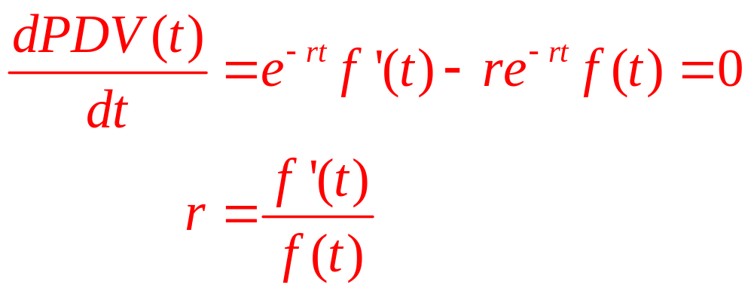
17.3 Cutting Down a Tree
When the tree is planted
  The present discounted value of the owner’s profits: PDV(t) = e^{-rt}f(t) - l
The forester’s decision
  Chose the harvest date, t, to maximize PDV(t)
  Note that l drops out (sunk cost)
  The tree should be harvested when r is equal to the proportional growth rate of the tree

Slide 49
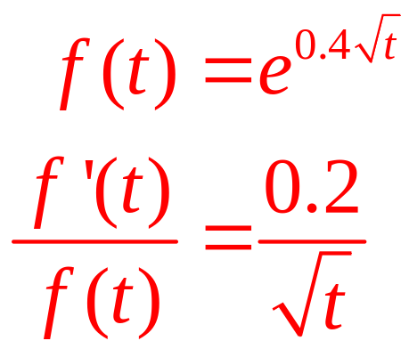
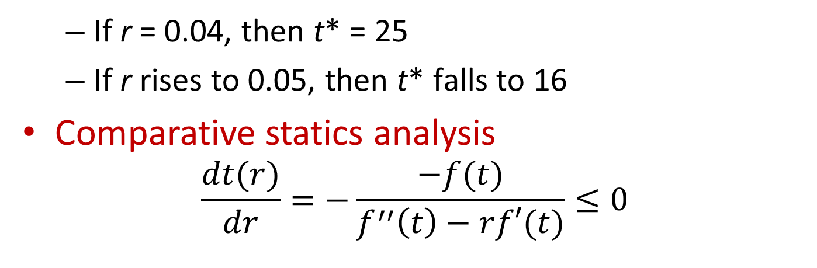
17.3 Cutting Down a Tree
Suppose that trees grow according to the equation:
  If r = 0.04, then t* = 25
  If r rises to 0.05, then t* falls to 16
Comparative statics analysis
$$\frac{dt(r)}{dr}=−\frac{−f(t)}{f^{′′}\left(t\right)−rf′(t)}≤0$$

Slide 50
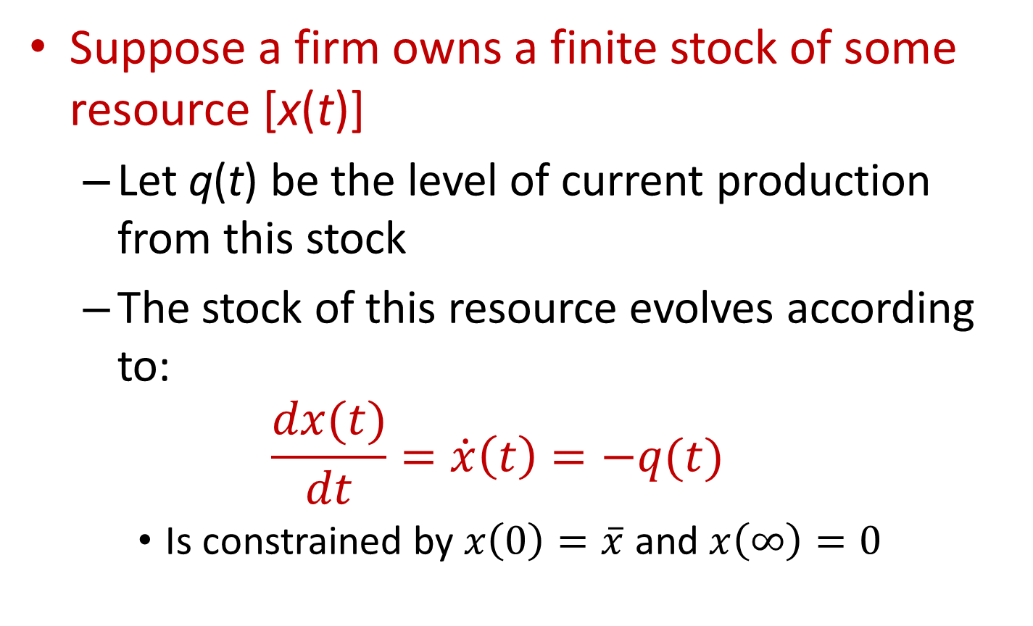
Natural Resource Pricing
Suppose a firm owns a finite stock of some resource [x(t)]
  Let q(t) be the level of current production from this stock
  The stock of this resource evolves according to:
  $$\frac{dx(t)}{dt}=\dot{x}\left(t\right)=−q(t)$$
    Is constrained by $x\left(0\right)=\overline{x}$ and $x\left(∞\right)=0$

Slide 51
Natural Resource Pricing
Extraction of the resource
  Exhibits constant AC and MC
The firm’s total costs: C(t) = c(t)q(t)
The firm’s goal
  Maximize the present discounted value of profits
  Subject to the constraint imposed by the stock of the resource available

Slide 52
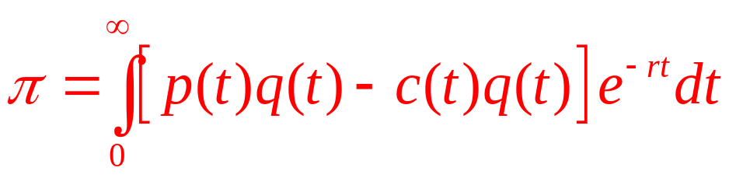
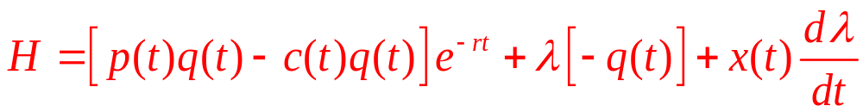
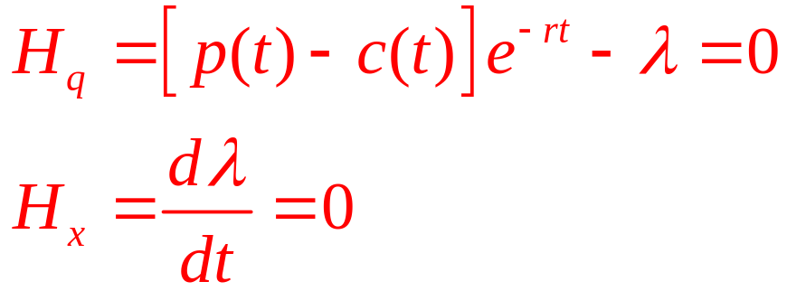
Natural Resource Pricing
Firm’s profits
  If p(t) = price of the resource at time t
  Augmented Hamiltonian:
  The first-order conditions for a maximum:

Slide 53
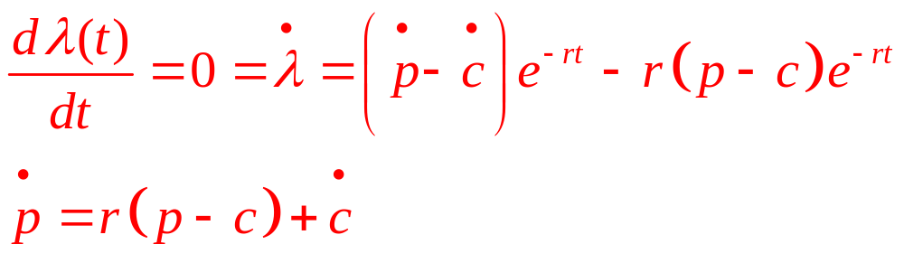
Natural Resource Pricing
Therefore
  The change in price has two components
    Upward trend reflecting the scarcity value of the resource
    Changes in marginal extraction costs

Slide 54
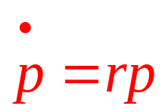
Natural Resource Pricing
Assume
  Marginal extraction costs are always zero
Whose solution is: p = p₀e^{rt}
  Prices increase exponentially at the real rate of interest

Slide 55
Natural Resource Pricing
Assume
  Marginal extraction costs follow an exponential trend: c(t) = c₀e^{γt}
    Where γ can be positive or negative
Then: p(t) = (p₀ – c₀)e^{rt} + c₀e^{γt}
Resource price is influenced by two trends
  An increasing scarcity rent that reflects the asset value of the resource
  The trend in marginal extraction costs

Slide 56
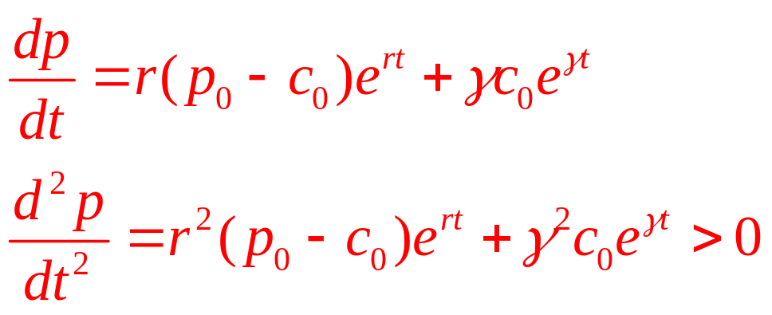
17.4 Can Resource Prices Decrease?
If marginal extraction costs decrease because of technical advances
  Then it is possible that the resource price will decrease
p(t) = (p₀ – c₀)e^{rt} + c₀e^{γt}
Calculating the first and second time derivatives of price

Slide 57
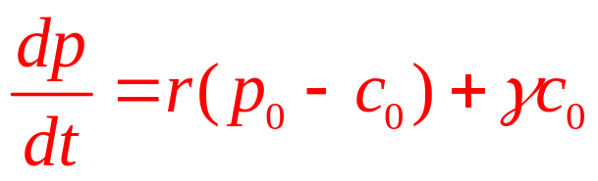
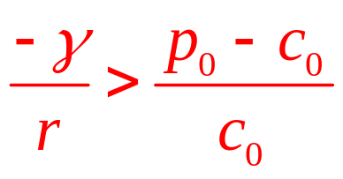
17.4 Can Resource Prices Decrease?
At t=0
  Second derivative > 0
  First derivative:
Prices will decrease (at least initially), providing

Slide 58
Generalizing the Model
Do these price trends maximize consumer surplus while maximizing the firm’s profits?
  Because individuals will consume any resource until its price is proportional to marginal utility, it seems plausible
  A more complete analysis would include the individual’s rate of time preference

Slide 59
Generalizing the Model
How should substitute resources be integrated into this analysis?
  If p₀ is determined by equilibrium and the prices of other resources follow a similar time trend, relative resource prices will not change
  If the new resource is a perfect substitute, its availability would put a cap on p₀

Slide 60
Generalizing the Model
The possibility that the resource in question is not finite:
  It can be renewed through natural or economic actions
  Requires a modification of the differential equation defining changes in the resource stock

Slide 61
The Mathematics of Compound Interest
Assume
  A current prevailing market interest rate of i per year
    Certain and constant over all future periods
$1 is invested at this rate i
  And if the interest is then compounded
  At the end of one period, $1 will be: $1 х (1 + i)
  At the end of two periods, $1 will be: $1 х (1 + i)²
  At the end of n periods, $1 will be: $1 х (1 + i)^{n}
So, $N grows like: $N х (1 + i)^{n}

Slide 62
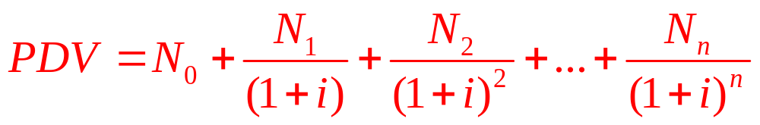
Present Discounted Value
The present value
  Of $1 payable one period from now = $1/(1+i)
  Of $1 payable n periods from now = $1/(1+i)^{n}
  Of $N payable n periods from now = $N/(1+i)^{n}
The present discounted value
  Of a stream of payments N₀, N₁, N₂,…, N_{n} is:

Slide 63
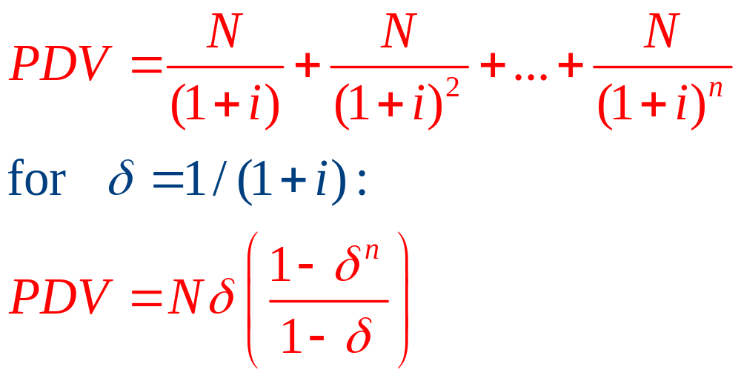
Annuities and perpetuities
An annuity
  Is a promise to pay $N in each period for n periods, starting next period
  The PDV of such a contract is:

Slide 64
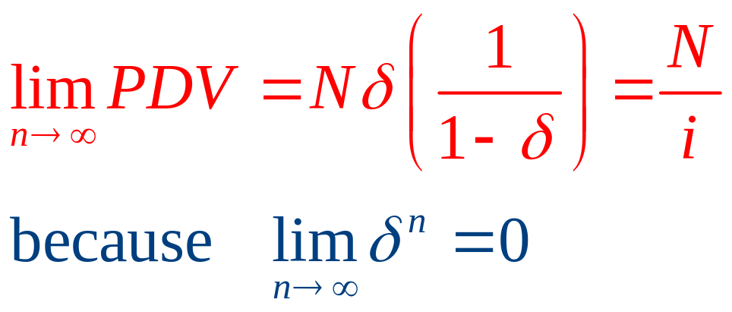
Annuities and perpetuities
A perpetuity
  An infinite-period annuity
  PDV of infinite annuity is:

Slide 65
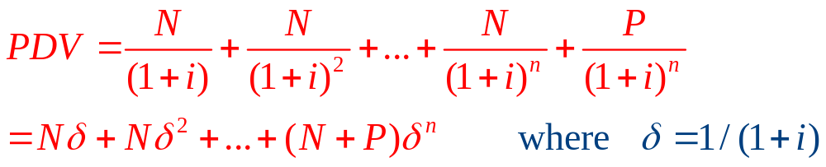
The special case of a bond
An n-period bond
  Is a promise to pay $N each period
    Starting next period, for n periods
  Promises to return the principal (face value), $P, of the bond at the end of n periods
  Present discounted value:

Slide 66
The special case of a bond
If we knew the price (B) at which the bond is currently trading
  Calculate yield on the bond, i:
    Best measure of the return actually available from the bond

Slide 67
Continuous Time
With continuous time
  Interest on an investment is compounded ‘‘instantaneously’’
  Growth over time is ‘‘smooth’’
For a nominal interest rate per year, i
  But half this nominal rate is compounded every six months
  At the end of one year, the investment of $1 would have grown to $1/(1+ i/2)²

Slide 68
Continuous Time
Continuous interest rate, r = ln (1 + i)
  $1 invested at a continuous interest rate of r, after T years will become V = $1·e^{rT}
  Present discounted value of $1 to be paid T years from now:
PDV = $1 / e^{rT} = $1 х e^{-rT}

Slide 69
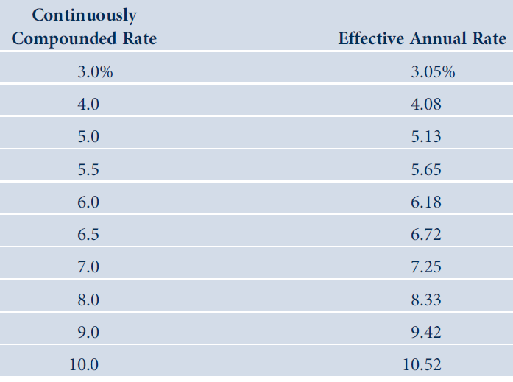
17 A. 1 Effective Annual Interest Rates for Selected Continuously Compounded Rates

Slide 70
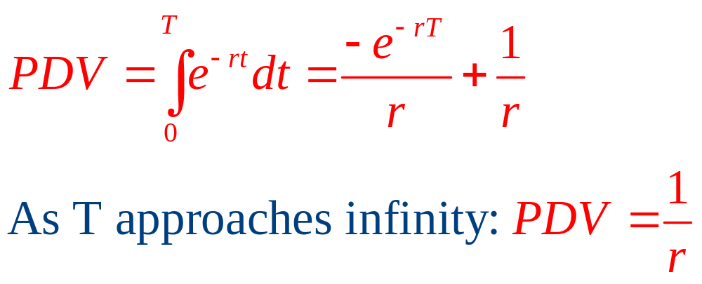
Continuous Time
Payment streams
  Calculate the PDV of $1 per period paid in small installments at each instant of time from today (time 0) until time T

Slide 71
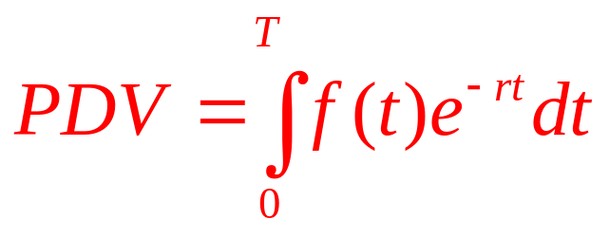
Continuous Time
The PDV of an arbitrary stream of payments over time
  If f(t) records the number of dollars to be paid during period t
    The PDV of the payment at time t is e^{–rt} f(t)
  The PDV of the entire stream from the present time (year 0) until year T is:

Slide 72
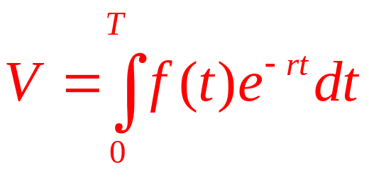
Continuous Time
Duration
  How long, on average, it takes for an individual to receive a payment from a given payment stream, f(t)
The present value of the stream

Slide 73
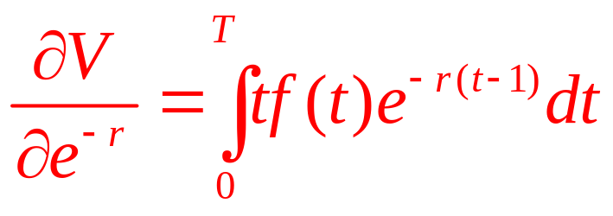
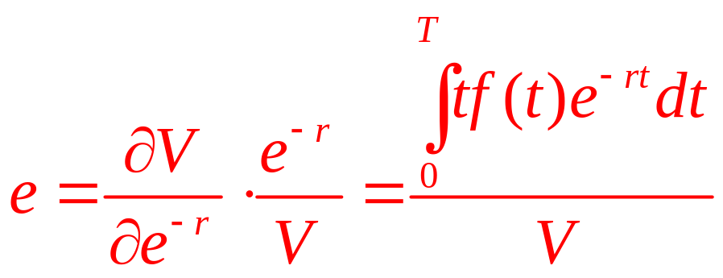
Continuous Time
  Differentiate by the discount factor, e^{–r}
  The elasticity of this change:
    The average time an individual must wait to receive the typical payment
    The duration of the payment stream

